Slide 1
A Brief Presentation on Large Language Models Encode Clinical Knowledge by Karan Singhal et al. (2023)
Prepared By
Sad Bin Sadain Mridha
Aims Lab UIU

Slide 2
Agenda
Introduction and Vision
Tasks and Datasets
Evaluation of Medical LLMS
Modeling
Results
Limitations and Ethical Considerations
Conclusions

Slide 3
Intersection of Medicine and language
Language enables interactions between clinicians, researchers and patients.
Human-AI collaboration is emerging as a key driver of more useful, responsible, and reliable AI systems.
However, in the medical domain, many models are narrow single task systems.
The language models are basically doing regression, classification, segmentation tasks.

Slide 4
The promise of Foundation Models
Large language models LLMS use language as a tool for mediating human AI interaction.
Can generalize and be repurposed across domains and tasks
Can encode and retrieve from large scale medical data
Can manipulate knowledge, produce explanations, and provide estimations of uncertainty.
Foundation models can extend to other modalities beyond text.
These advances offer a opportunity to rethink medical AI systems.

Slide 5
Vulnerabilities
Safety :LLMS often produce hallucinations, amplify biases present in their training data and display deficiencies in their reasoning abilities
Benchmarks: There is no standard set of benchmarks for testing the clinical knowledge of large language models.
Human Evaluation: The safety critical nature of the domain necessitates thoughtful development of evaluation frameworks, enabling researchers to meaningfully measure progress and capture and mitigate potential harms.

Slide 6
Model Tasks
Answering Medical Questions
Comprehension skills
Recall or medical knowledge
Manipulation of expert knowledge
Training patients Concerns
Knowledge Retrieval
Clinical Decision Support
Summarization
Medical Question Answering

Slide 7
MultiMedQA: Medical Question Answering Benchmark
Existing benchmarks are
Inherently Limited and only
provide partial coverage of the
Space of
medical
knowledge.
HealthsearchQA
MultiMedQA
LIVEQA TREC 2017
MedQA
(USMLE)
MedicationQA
MedMcQA
PubMedQA
MMLU

Slide 8
MultiMedQA
We need to evaluate beyond multiple choice questions accuracy or
NLP generation metrics such as BLEU Score.
MultiMedQA probes Different abilities.
Long form answer questions
Multiple choice questions
Open domain vs closed domain
Medical exams, medical research, consumer questions.

Slide 9
MultiMedQA: Summary
Dataset | Format | Size(Dev/test) | Domain
MedQA(USMLE) | Q + A (4-5 Choices) | 11450/1273 | General medical knowledge in US medical licensing exam
MedMCQA(AIIMS/NEET) | Q + A (4 Choices and Explanations) | 187k/6.1K | General Medical knowledge in Indian Medical Entrance Exams
PubMedQA | Q +Context + A (Yes/No/Maybe) (Long Answer) | 500/500 #QA pairs : Labeled:1K Unlabeled:61.2K Synthetic:211.3K | Biomedical Scientific Literature
MMLU | Q + A (4 choices) | 123/1089 | Medical Knowledge covering anatomy, clinical knowledge, clinical medicine, medical genetics, professional medicine and college biology
LiveQA TREC 2017 | Q + Long Answer (Librarian answers) | 634/104 | General Medical knowledge sought by consumers
MedicationQA | Q + A (Long Answer) | NA/674 | Medication Knowledge frequently sought by consumers
HealthSearchQA | Q + Manual Expert Evaluation | 3375 | General Medical Knowledge Searched By the Consumers

Slide 10
MultiMedQA Summary
Dataset: MedQA(USMLE)
Format: Q+A(4 to 5 choices)
Size=(dev/test) 11450/1273
Domain: General medical knowledge in Us medical licensing exam.

Slide 11
Pathways Language Model
780B training tokens (78% English ,22% Multilingual)
Vocabulary improvements for math, code and reasoning
Palm Models
Palm 8B
Palm 62B
Palm 540B
At the time of release palm 540B achieved breakthrough performance was SOTA on a suite of multistep reasoning tasks and extended average human performance on Big Benchmarks.

Slide 12
Palm Model
Total dataset size=780 billion tokens
Data source | Proportion of data
Social Media Conversations (Multilingual) | 50%
Filtered Webpages (Multilingual) | 27%
Books (English) | 13%
Github(Code) | 5%
Wikipedia((Multilingual) | 4%
News (English) | 1%

Slide 13
Flan-Palm
Flan palm is the instruction tuned counterpart of palm, the model reached SOTA performance on several benchmarks such as MMLU,BBH,and TYDQIA and outperformed palm by an average of 9.4% across a suite of evaluation tasks.
Instruction Finetuning
Language Model
Chain of Thought Finetuning
Please answer the following question
What is the Capital of France?
The Capital of France is Paris.

Slide 14
Data Efficient Alignment Strategies
Prompting strategies: Adapt to diverse tasks without
gradient based parameter updates.
Flan Palm(540B)
Flan Palm(540B)
Few Shot Prompting
Chain of Thought Prompting
Prompt Tuning
Instruction Prompt Tuning
Self Consistency Prompting
Prompt Tuning: Simple and Computationally inexpensive gradient based parameters updates based on learning of soft prompt vectors.

Slide 15
Chain of Thought Prompting
Whereas standard prompting asks the model to directly give the answer to a multi step reasoning problem. Chain of thought prompting induces the model to decompose the problem into intermediate reasoning steps, leading to final answer.
COT prompting is inference.
Chain-of-thought not only solves cognitive tasks but also provides insights into the inner workings of the model.

Slide 16
Self Consisting Prompting
Prompt a language model using chain of thought examples
Sample from the language models decoder to generate a diverse set of reasoning paths
Choose the most consistent answer using a majority/plurality vote.
Ask the model for multiple reasoning paths and explanations.

Slide 17
Prompt Tuning
The approach involves the learning of soft vectors through backpropagation while keeping the rest of the LLM frozen, thus allowing easy reuse of a single model across tasks, Prompt tuning can be thought of as using a fixed prompt of special tokens, where only the embeddings of as using a fixed prompt of special tokens, where only the embeddings of these prompt tokens can be updated.

Slide 18
Instruction Tuning
Instruction tuning finetunes a language model on a collection of NLP tasks described using instructions. Instruction tuning helps the model perform tasks it wasn’t trained on, giving the model a range of applications.

Slide 19
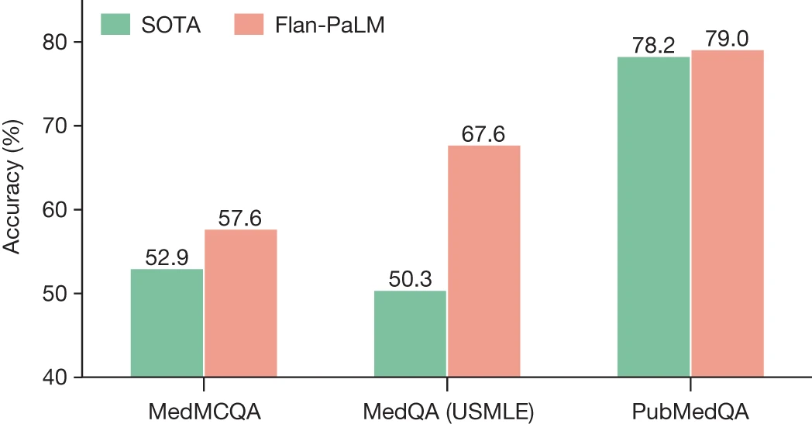
Results and Experiments

Slide 20
Continuation of the Previous Slide
The model achieved SOTA performance on MedQA(USMLE)
MedMcQA,and PubMedQA datasets with their Flan palm 540B model,SOTA results come from Galactica (MedMcQA) and BioGPT(PubMedQA)

Slide 21
Limitations
1.Expansion of MultiMedQA
While the MultiMedQA benchmark is diverse and contains questions from a variety of professional medicine, medical research and consumer sources.it is by no means exhaustive. Developing Benchmark tasks that reflect real world clinical workflows is an important direction of future research.

Slide 22
Limitations
2.Improving Human Evaluation
The approach in this study represents a promising outlook but the chosen axes of evaluation were subjective in nature and it reflects in the understandings of human health and disease. The number of clinicians and lay people assessing were limited.

Slide 23
Conclusion
The advent of foundation AI models and large language models present a significant opportunity to rethink the development of medical AI.
These models deployed in the field can be truly groundbreaking for health AI intersection. But there are more models in the industry than working functioning one which makes life easier for the people.
This study could be helpful for patients, consumers, AI researchers, clinicians to a better healthcare.

